Slide 1


Jurriaan Engels
21-2-2023

Slide 2

Table of Contents
Executive Summary
Introduction
Methodology
Results
Conclusion
Appendix

Slide 3
Executive Summary
Summary of methodologies
Data collection from SpaceX API and Wikipedia page.
Data wrangling and cleaning, including new Column "Class" an indicator for successful landings.
Exploratory Data Analysis using SQL and visualizations.
Generated interactive maps using Folium.
Generated interactive website dashboard with Plotly and Dash.
Trained various classification models to predict successful landings given the cleaned feature dataset.
Summary of all results
The machine learning classification models all produced identical results, with an accuracy of 83,33% on the test set. All models attained 3 False positives and 0 False negatives. To make the models more distinct, and to gain a higher accuracy, training with more data is adviced.

Slide 4
Introduction
Goal of the project and context
The goal of this project is to predict whether or not a SpaceX rocket will land successfully.
SpaceX advertises Falcon 9 rocket launches on its website, with a cost of 62 million dollars; other providers cost upward of 165 million dollars each, much of the savings is because SpaceX can reuse the first stage.
From an investment perspective, if we can predict whether the first stage will land, we can determine the cost of a launch. We from SpaceY, can use this information to bid against SpaceX should a rocket fail to land (based on our predictions).
Problems we want to find answer to:
How do we predict whether a rocket lands successfully?
Which features determine if a rocket will land successfully?
What are the optimal conditions to achieve a successful landing?

Slide 5

Section 1

Slide 6
Methodology
Executive Summary
Data collection methodology:
Data collected from SpaceX REST API.
Data collected from SpaceX Wikipedia page using web scraping.
Perform data wrangling
Information removed that was not relevant, general data cleaning.
Performed One Hot encoding technique to relevant columns.
Perform exploratory data analysis (EDA) using visualization and SQL
Perform interactive visual analytics using Folium and Plotly Dash
Perform predictive analysis using classification models
Built, trained and evaluated classification models using Sklearn and GridSearch libraries.

Slide 7
Methodology
SpaceX REST API
Data collected from SpaceX REST API: https://api.spacexdata.com/v4/. Features included amonst other things: rocket name, launchpad, payloads, cores, booster version, flight number in the form of a .Json file. We tranformed the data to a .DataFrame file (using Pandas), replaced null values and transformed the data to a .csv file (using Pandas).
Web scraping SpaceX Wikipedia
Data collected from SpaceX Wikipedia page: https://en.wikipedia.org/w/index.php?title=List_of_Falcon_9_and_Falcon_Heavy_launches&oldid=1027686922. Obtained a raw HTML file containing a table on launch data. Scraped the file using the BeautifulSoup library to locate the table, and transformed the table to a .DataFrame file and consequently to a .csv file.

Slide 8
Data Collection – SpaceX API
See Flowchart
GitHub
Request response
From SpaceX REST API URL
Convert response to Json file
Filter to Falcon9 launches
Export to .csv file
Creating
Dictionary
For features
Create pandas
DataFrame

Slide 9
Data Collection - Scraping
See Flowchart
GitHub
Request response
From SpaceX Wikipedia
Create HTML file
Create a dictionary
Create DataFrame and
Export to .csv file
Create BeautifulSoup object
Use function in BS to find table

Slide 10
Data Wrangling
We specified the feature 'Outcome' to a more readable column 'Class'. Where a successful landing in outcome resulted in a '1' in the new column, and unsuccessful corresponded to a '0'
GitHub

Slide 11
EDA with Data Visualization
The objective
We used Exploratory Data Analysis to see the relationship between the features Flight Number, Launch Site, Orbit, Class, Year and Payload Mass.
The charts
Scatter plots:
Flight Number vs Payload Mass,
Flight Number vs Launch Site,
Payload vs Launch Site,
Orbit vs Flight Number,
Payload vs Orbit Type,
Orbit vs Payload Mass
Bar chart:
Mean vs Orbit
Line chart:
Success percentage vs Year
GitHub

Slide 12
EDA with SQL
The objective
We used Exploratory Data Analysis in SQL to better understand the data.
The queries performed
Displaying the names of the unique launch sites.
Displaying 5 records where launch sites begin with the string 'CCA'.
Displaying the total payload mass carried by boosters launched by NASA (CRS).
Displaying the average payload mass carried by booster version F9 v1.1.
Listing the date when the first successful landing outcome in ground pad was achieved.
Listing the names of the boosters which have success in drone ship and have payload mass greater than 4000 but less than 6000.
Listing the total number of successful and failure mission outcomes.
Listing the names of the booster versions which have carried the maximum payload mass.
Listing the records for the months in 2015.
Ranking the count of successful landing outcomes between the date 2010-06-04 and 2017-03-20 in descending order.
GitHub

Slide 13
Build an Interactive Map with Folium
The objective
The launch success rate may depend on many factors such as payload mass, orbit type, and so on. It may also depend on the location and proximities of a launch site, i.e., the initial position of rocket trajectories. Finding an optimal location for building a launch site certainly involves many factors and hopefully we could discover some of the factors by analyzing the existing launch site locations.
The action I took
I used Folium to visualize the locations of the launches on an interactive map. Furthermore, I added markers and circles to indicate the sites. Additionally, I used MarkerCluster in Folium to highlight successful outcomes with green and unsuccesful with red. Additionally, I calculated the distances to the nearest coast, highway, railroad and city and visualized this using lines in Folium.
GitHub

Slide 14
Build a Dashboard with Plotly Dash
Using the library Plotly Dash, I generated an interactive dashboard which includes a dropdown list, slider, piechart and scatterplot.
The piechart highlights the success percentage of all, or each individual launch site. The scatterplot highlights the relation between the successes, the payload mass and booster version.
GitHub

Slide 15
Predictive Analysis (Classification)
Using the Sklearn library I made logistic regression, SVM, decision tree and KNN classifiers to predict whether or not a SpaceX rocket succeeds in landing. See flowchart.
GitHub
Obtaining independent and dependent features
Using StandardScaler to transform data
Using GridSearch on the models and data
Determine accuracy and confusion matrix
Plotting the barchart of the accuracies of the models
Splitting data into training and test set
Fitting the classification models

Slide 16
Results
Results are displayed in the following slides in the order of:
Exploratory Data Analysis results
Interactive Analytics Demo in screenshots
Predictive Analysis results

Slide 17

Section 2

Slide 18
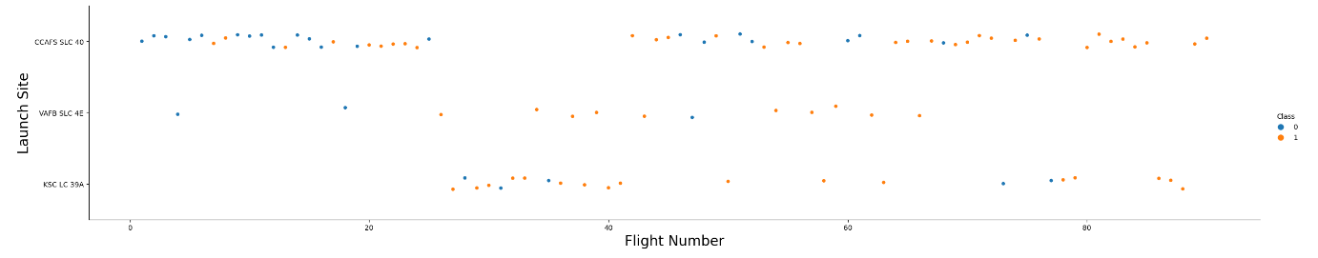
Flight Number vs. Launch Site
Blue indicates an unsuccessful launch, orange indicates a successful launch.
We can see that in the beginning a lot of unsuccessful launches happened. But this certainly improved over time. What is more, the most launches are currently done by CCAFS SLC 40.

Slide 19
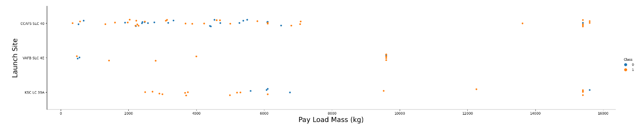
Payload vs. Launch Site
Blue indicates an unsuccessful launch, orange indicates a successful launch.
Clearly, unsuccessful launches happen more often when the pay load is not high.

Slide 20
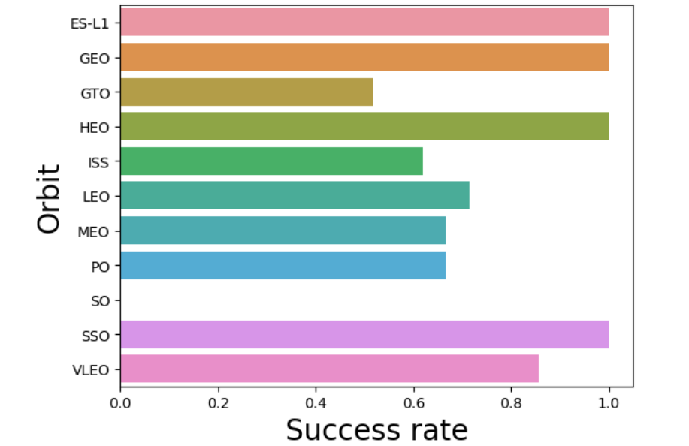
Success Rate vs. Orbit Type
The orbits ES-L1, GEO, HEO, SSO all have success rate of 100%.
The orbit GTO has the lowest success rate.

Slide 21
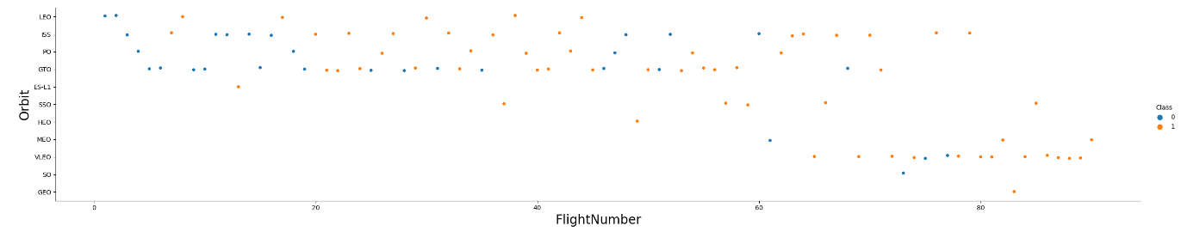
Flight Number vs. Orbit Type
Blue indicates an unsuccessful launch, orange indicates a successful launch.
We can see that the has been a change in the selection of orbits. We also see that the success rate is higher for recent flight numbers – thus this new selection of orbits has definitely influenced the success rate positively.

Slide 22
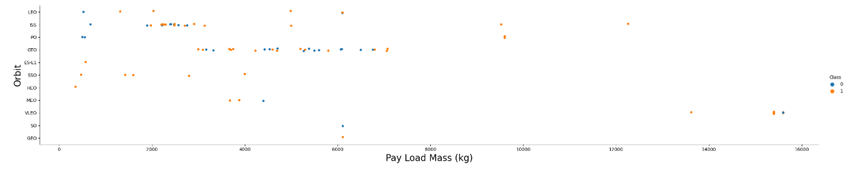
Payload vs. Orbit Type
Blue indicates an unsuccessful launch, orange indicates a successful launch.
With heavy payloads the successful landing or positive landing rate are more for Polar, LEO and ISS.
However for GTO we cannot distinguish this well as both positive landing rate and negative landing(unsuccessful mission) are both there here.

Slide 23
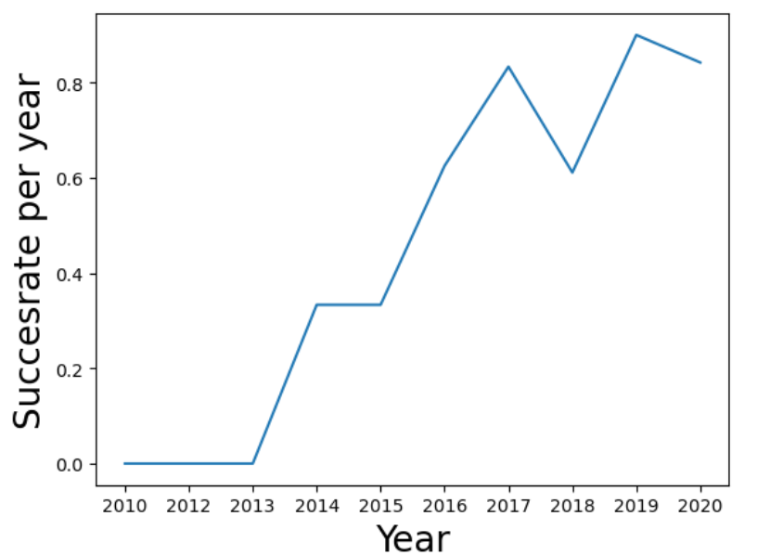
Launch Success Yearly Trend
You can observe that the success rate since 2013 kept increasing till 2020 with a slight decrease in 2018.

Slide 24
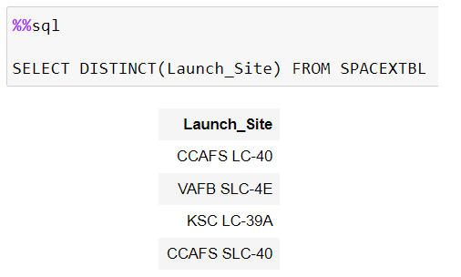
All Launch Site Names
The query returns unique launch site names.
We find 4 different launch sites, however we will see later that launch sites CCAFS LC-40 and CCAFS SLC-40 are very close to each other geographically and also have almost identical names. For the time being, we let them be distinct launch sites.

Slide 25
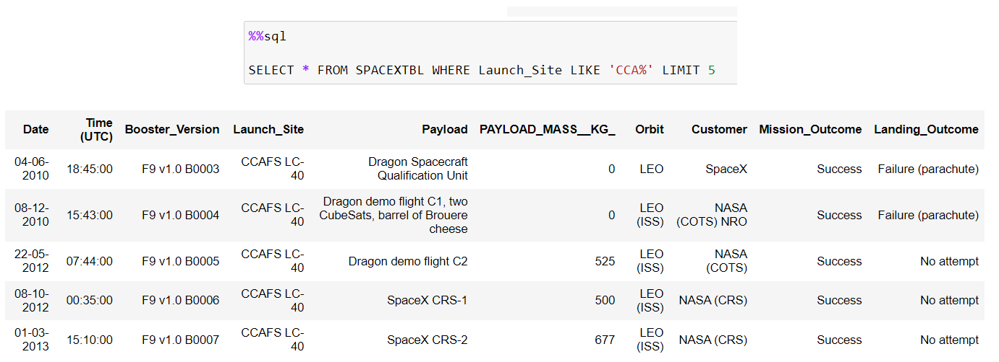
Launch Site Names Begin with 'CCA'
Find 5 records where launch sites begin with `CCA`
Present your query result with a short explanation here
The query returns first 5 records where launch site name begins with 'CCA'.

Slide 26
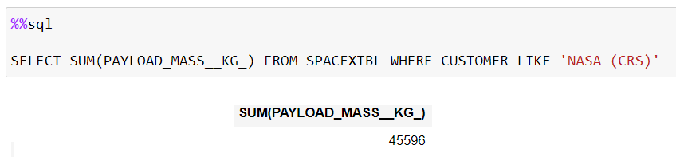
Total Payload Mass
Query results total sum of payload mass for all records where the customer is 'NASA (CRS)'.

Slide 27
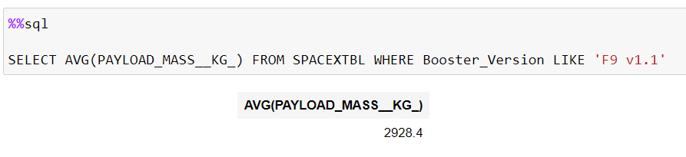
Average Payload Mass by F9 v1.1
The query results in the average payload mass where booster version is 'F9 v1.1'.

Slide 28
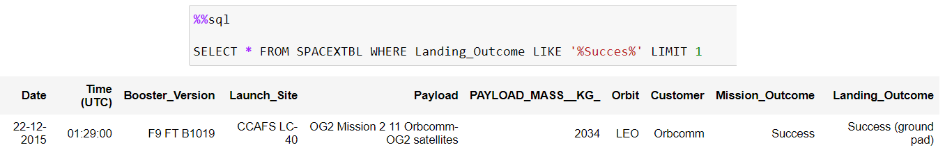
First Successful Ground Landing Date
The query results the first record where landing outcome is a success

Slide 29
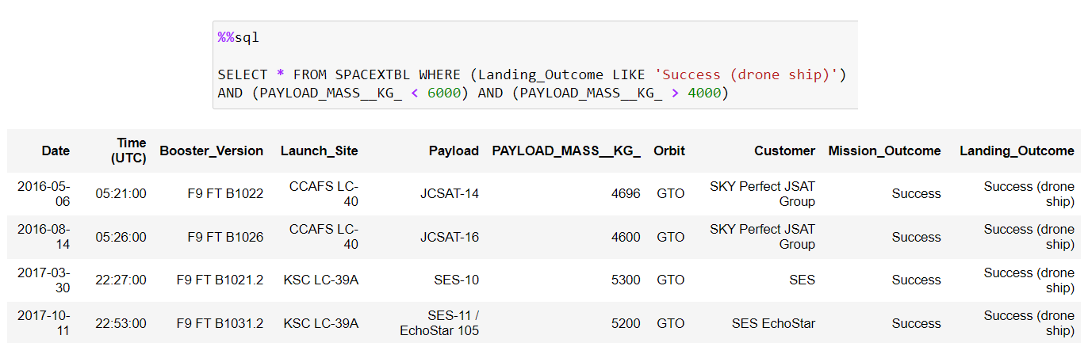
Successful Drone Ship Landing with Payload between 4000 and 6000
The query results in the successful drone ship landing with payload mass between 4k and 6.

Slide 30
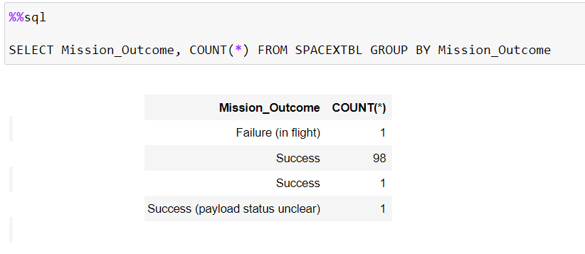
Total Number of Successful and Failure Mission Outcomes
The query results in the total number of successful and failure mission outcomes.

Slide 31
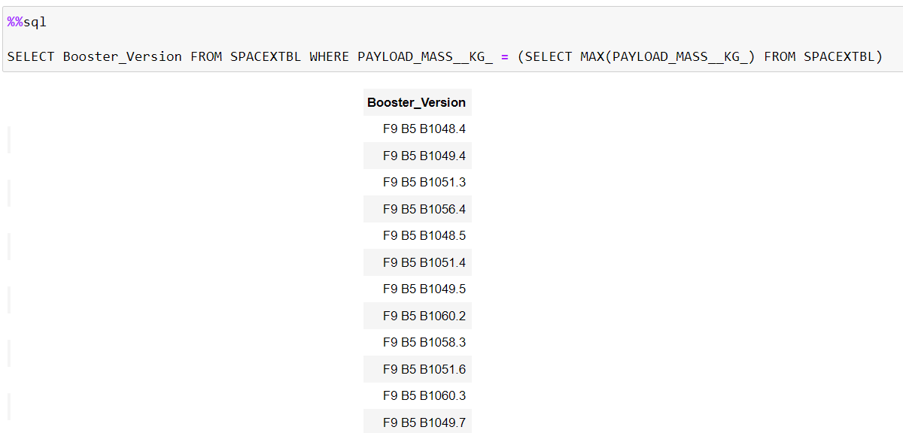
Boosters Carried Maximum Payload
The query results in the boosters with maximum payload mass.

Slide 32
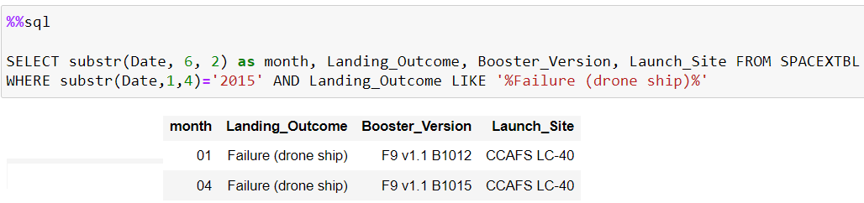
2015 Launch Records
Query results in the launch records of 2015 where the landing outcome was 'Failure (drone ship)'.

Slide 33
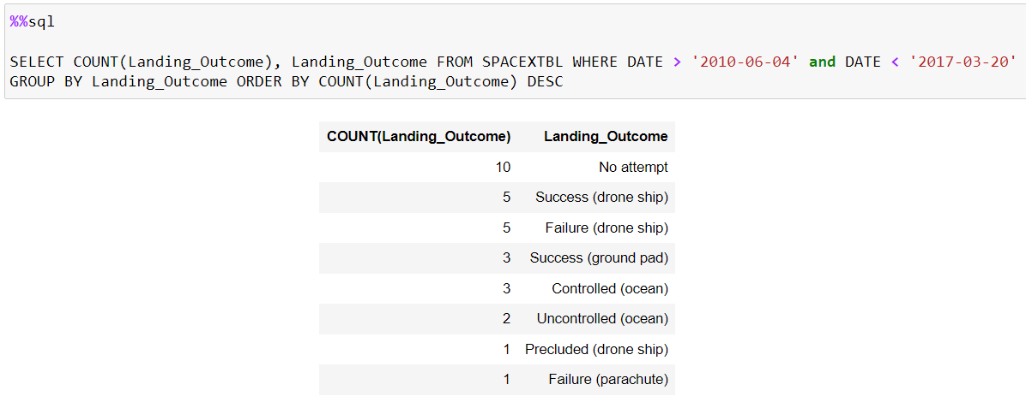
Rank Landing Outcomes Between 2010-06-04 and 2017-03-20
Query results in a rank of the landing outcomes between 2010-06-04 and 2017-03-20.

Slide 34

Section 3

Slide 35
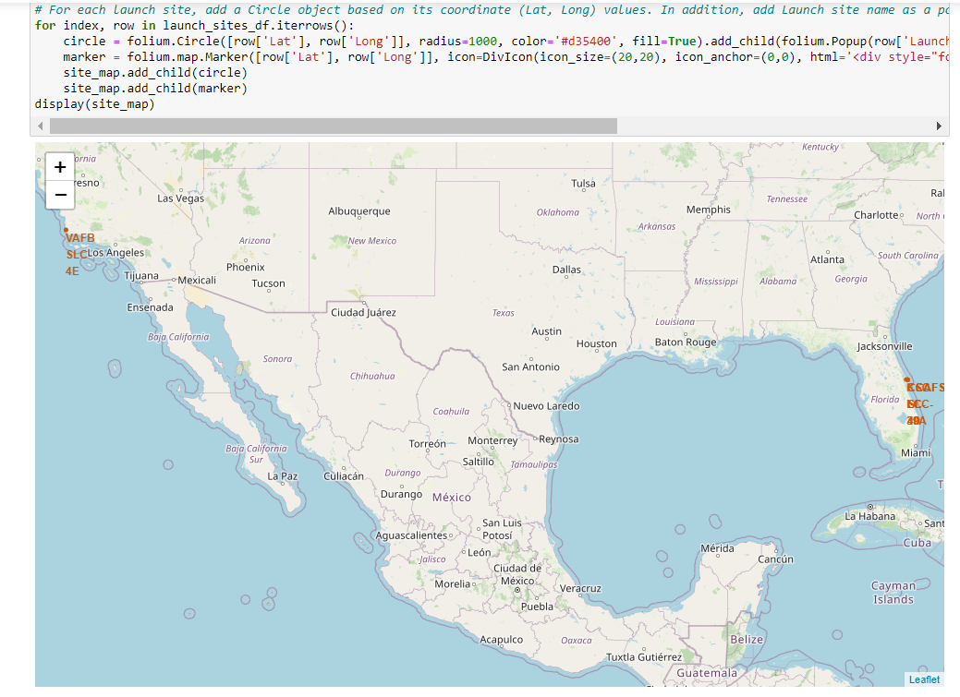
All launch sites
If we zoom in, we can see that there are four distinct launch sites from where a Falcon9 rocket has been launched.

Slide 36
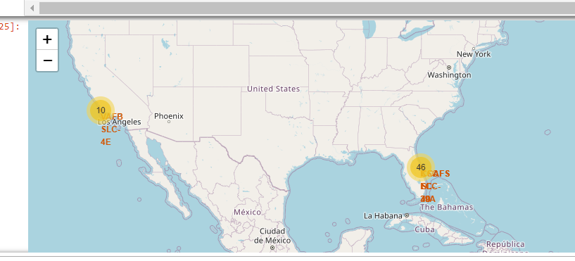
Succes or failures on a map
At each launch site we can also highlight whether or this rocket has made a successful landing or not. On the left we see that there are 10 launches clustered together at the site VAFB SLC –4E.

Slide 37
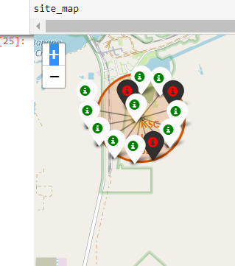
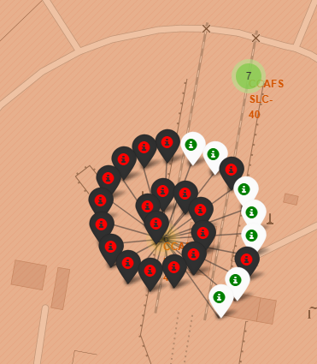
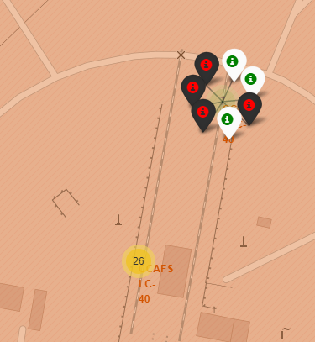
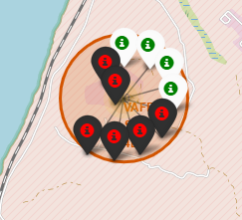
Succes or failures on a map
From left to right: KSC LC-39A, ,CCAFS LC-40 ,CCAFS SLC-40 VAFB SLC-4E. Green highlights a success, red highlights a failure.

Slide 38
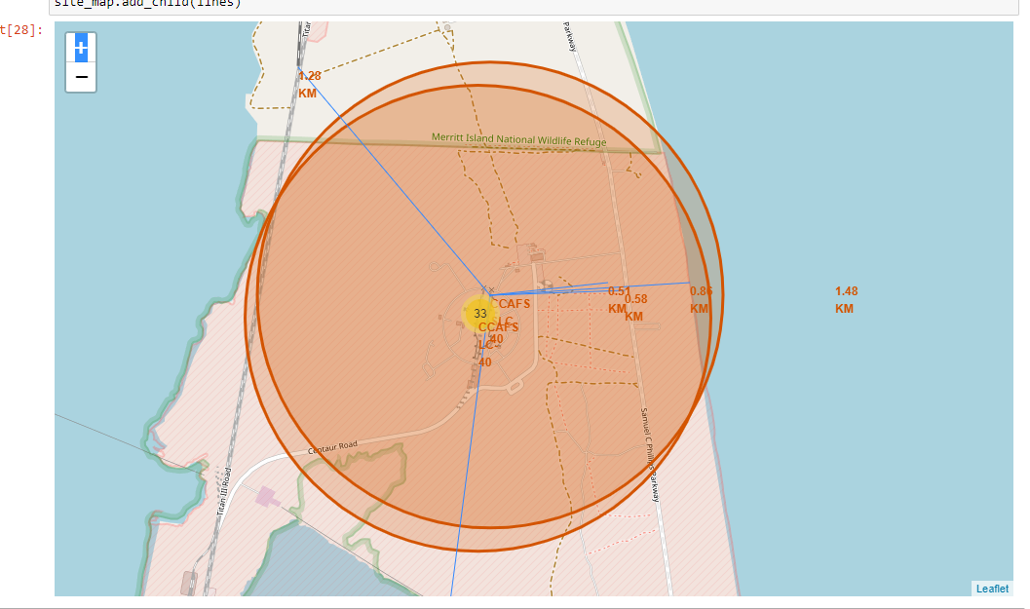
A map to indicate the closest coastline, railroad, road and city (Melbourne)
We can see that the closest coastline is 0.86 KM, closest highway is 0.58 KM, closest railway is 1.28 KM, and closest city is 51,43 KM.

Slide 39

Section 4

Slide 40
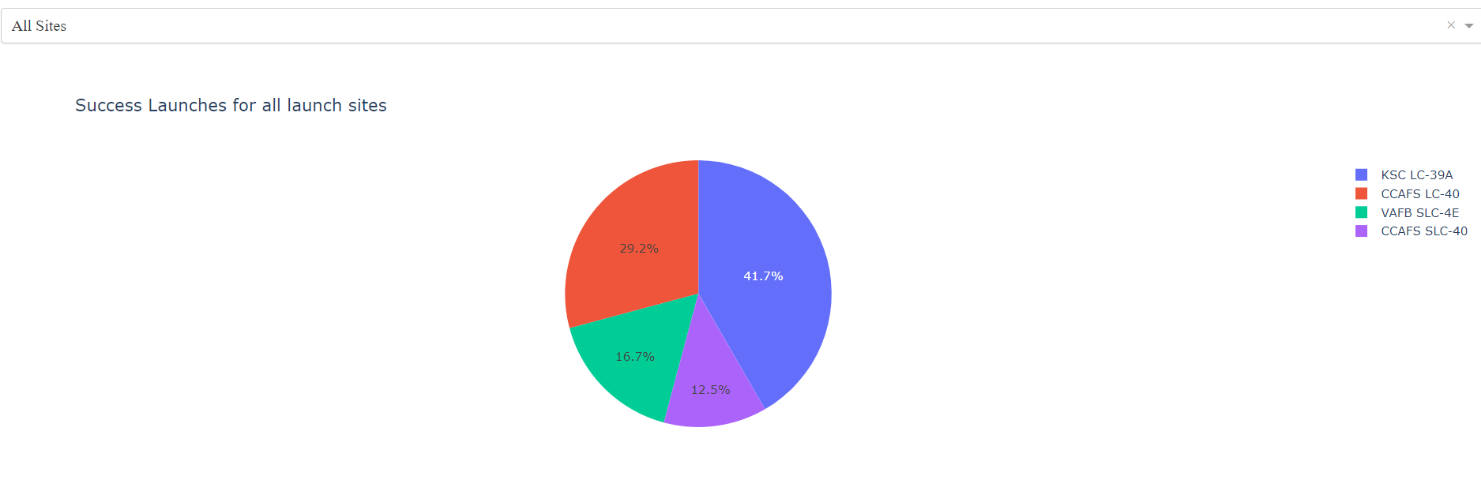
Piechart of success percentage of all launch sites
We can see that KSC LC-39A has the site with the most success launches

Slide 41
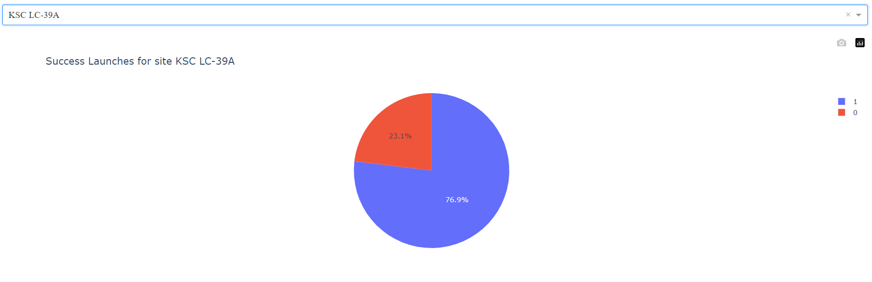
Success launches for site KSC LC-39A
Replace <Dashboard screenshot 1> title with an appropriate title
Show the screenshot of launch success count for all sites, in a piechart
Explain the important elements and findings on the screenshot
Of the launches from KSC LC-39A, 76.9% were successful.

Slide 42
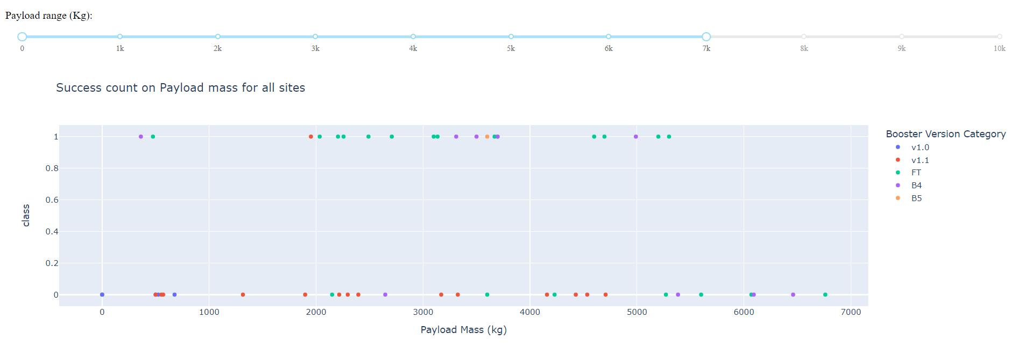
Scatterplot of Payload vs Success/Fail where Payload is max 7000 kg
Replace <Dashboard screenshot 3> title with an appropriate title
Show screenshots of Payload vs. Launch Outcome scatter plot for all sites, with different payload selected in the range slider
Explain the important elements and findings on the screenshot, such as which payload range or booster version have the largest success rate, etc.
We can see that booster version FT has the most successes. Whereas v1.1 has the most failures. Note that we took the slider to max 7k, and min 0.

Slide 43
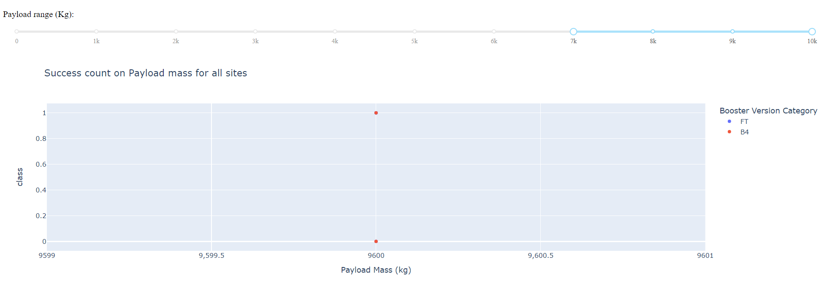
Scatterplot of Payload vs Success/Fail where Payload is min 7000 kg
Replace <Dashboard screenshot 3> title with an appropriate title
Show screenshots of Payload vs. Launch Outcome scatter plot for all sites, with different payload selected in the range slider
Explain the important elements and findings on the screenshot, such as which payload range or booster version have the largest success rate, etc.
If the rocket has a payload of atleast 7k kg, then there are only records of a rocket with booster version B4.

Slide 44

Section 5

Slide 45
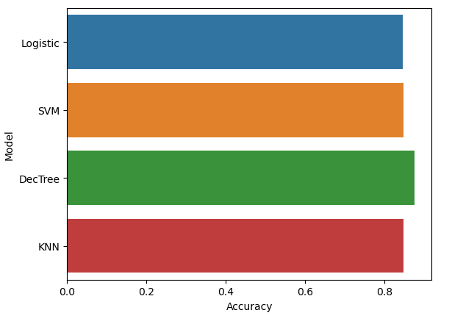
Classification Accuracy
We can see that the Decision Tree model has the highest accuracy on the training data.

Slide 46
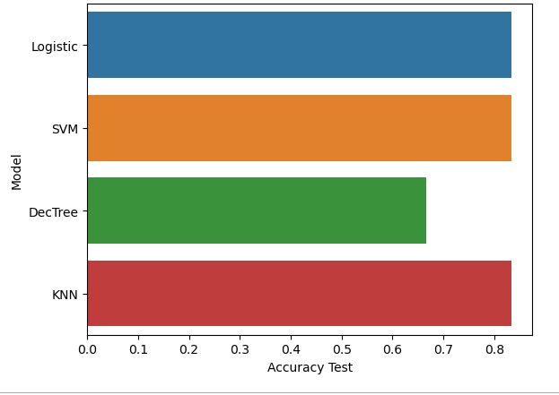
Classification Accuracy
However, on the test set, the model performs worse. If we had to pick a best model, then we pick KNN, because KNN has the highest accuracy on the test and on the training data (0.8482142857142858).
Training on more data is advised, since the accuracies are all very close to each other.

Slide 47
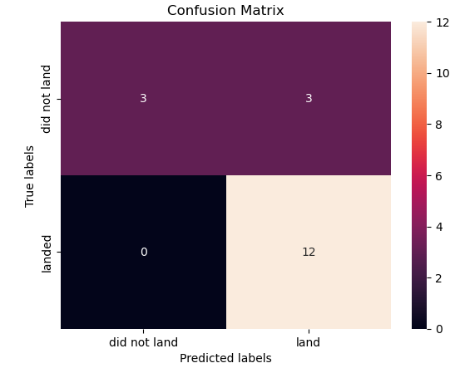
Confusion Matrix
The confusion matrix of the KNN model shows us that we have zero False Negatives and 3 False Positives.

Slide 48
Conclusions
The objective of this Capstone project was to predict the stage 1 of a rocket of SpaceX will land succesfully or not using Exploratory Data Analysis and machine learning models.
We developed four classification models: logistic regression, SVM, decision tree and KNN. They all had similar accuracy. The models are able to be improved by training on more data.
We have also found that the landings success is improving over time, the orbits ES-L1, GEO, HEO, SSO have 100% success rate, that KSC LC-39A has the most successful launches and where the sites are located.

Slide 49
Appendix
GitHub URL to entire repository of the Capstone project
Thank you to the IBM team for this Capstone project!

Slide 50


